Slide 1

GREEN QR: SMART TREE INFORMATION SYSTEM
by
A Chaithanya
Roll No. 224G1A0513
B Shantha Vardhan
Roll No. 224G1A0597
V Likith Kumar
Roll No. 224G1A0542
Under the guidance of
Dr. P. Veera Prakash , M.Tech, Ph.D
Assistant Professor
Department of Computer Science and Engineering
Srinivasa Ramanujan Institute of Technology
Autonomous
Rotarypuram Village, B K Samudram Mandal, Ananthapuramu – 515701.
Accredited by NBA & NAAC with “A” Grade,Affiliated to JNTUA,Ananthapuramu
2025-2026

Slide 2
Queries From Review 0
What is the main objective of your project?
Why did you choose QR code?
Is this a web application or mobile application?
Is this an iot project?
What is QR code?

Slide 3
Title Explaination
The title “Green QR: Smart Tree Information System” reflects the core idea of the project using QR codes to provide verified, structured, and app-secured information about every tree.
It highlights:
Green → Represents trees, environment, sustainability.
QR → Technology used to uniquely identify each tree.
Smart Information System → Indicates the digital, secure, app-based data retrieval method.

Slide 4
Contents
Abstract
Introduction
Software Requirements
Datasets/Modules
Implementation
Outputs
Conclusion
References

Slide 5
Abstract
The Green QR Smart Tree Information System aims to promote environmental awareness by providing digital information about trees using QR code technology.
Existing tree management practices lack a standardized, interactive system for real-time information access, monitoring, and public awareness.
Each tree is assigned a unique QR code linked to a centralized database containing species data, geo-location, plantation details, and ecological value.
The proposed system enables quick, accurate access to verified tree information through mobile devices, enhancing transparency and environmental engagement.
The Green QR system demonstrates an efficient, scalable, and eco-friendly solution that supports smart campus initiatives and sustainable environmental management.

Slide 6
Introduction
This project is designed to create a smart tree information system using QR codes, allowing users to scan and access detailed information about any tree instantly.
It helps in environmental awareness by educating people about tree species, their benefits, and conservation methods, making learning interactive and modern.
I chose this project to combine technology with nature, providing a digital solution for tree identification and information sharing, which is not widely available.
It also gives practical exposure to QR code technology, web or mobile development, and database management, enhancing technical and problem-solving skills.
This project is unique because it bridges technology and environmental education, making tree data accessible anytime, anywhere, and promoting eco-friendly habits.
This project is unique because it bridges technology and environmental education, making tree data accessible anytime, anywhere, and promoting eco-friendly habits.

Slide 7
Software Requirements
Development Tools / IDEs
Visual Studio Code
Programming / Markup Languages
HTML5
CSS3
JavaScript

Slide 8
Datasets/Modules
Datasets / Modules
User Module
Dataset: Stores registered user information.
Fields: Username, Email, Password (hashed), Terms Accepted.
Purpose: Handles user registration, login, and authentication.
Tree Module
Dataset: Stores details of trees in the system.
Fields: Tree ID, Tree Name/Type, QR Code, Location, User ID (tree owner).
Purpose: Generates unique QR codes and tracks tree ownership.
Green Wealth Card Module
Dataset: Stores users’ contributions and rewards.
Fields: Card ID, User Name, User ID, Reward Points, Tree Linked.
Purpose: Displays user’s green contributions and reward points.

Slide 9
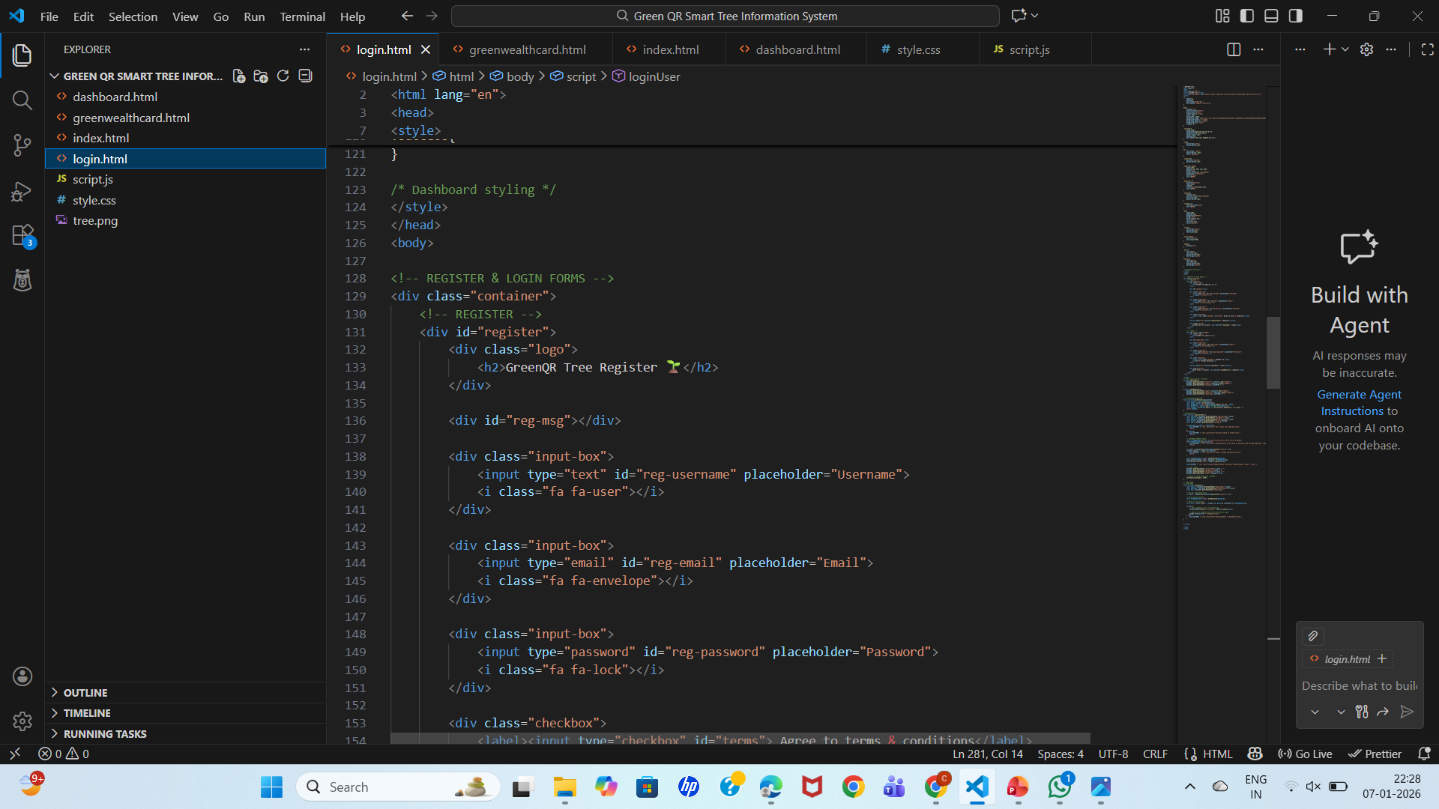
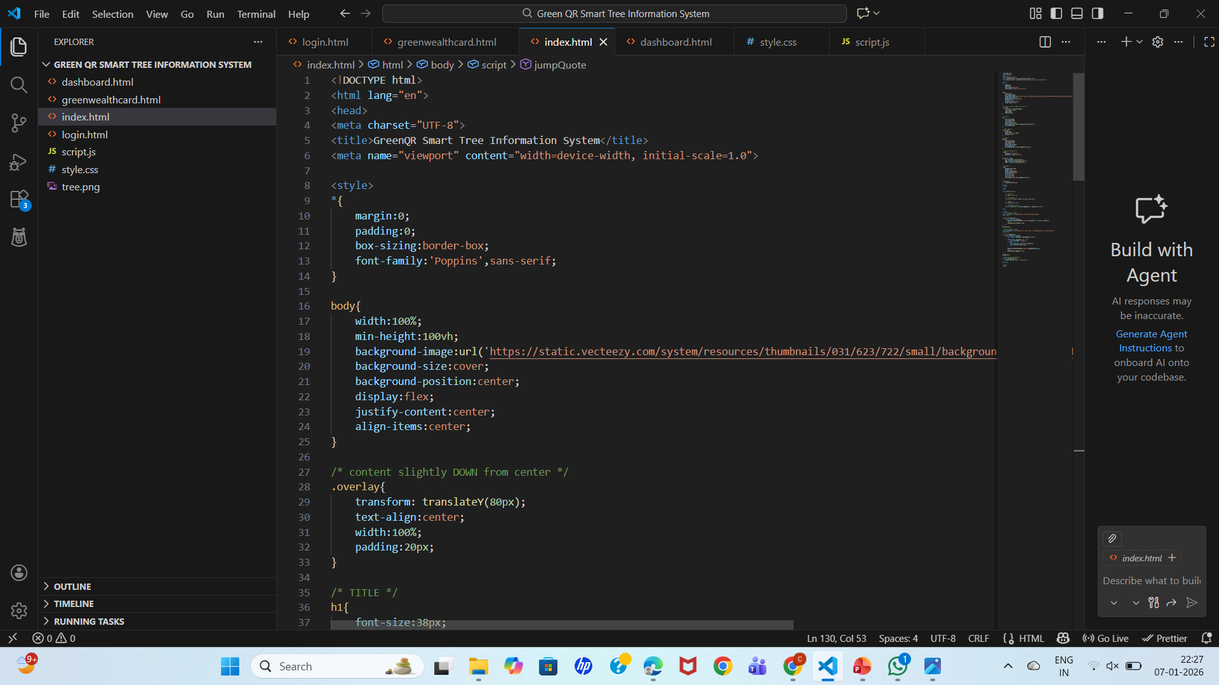
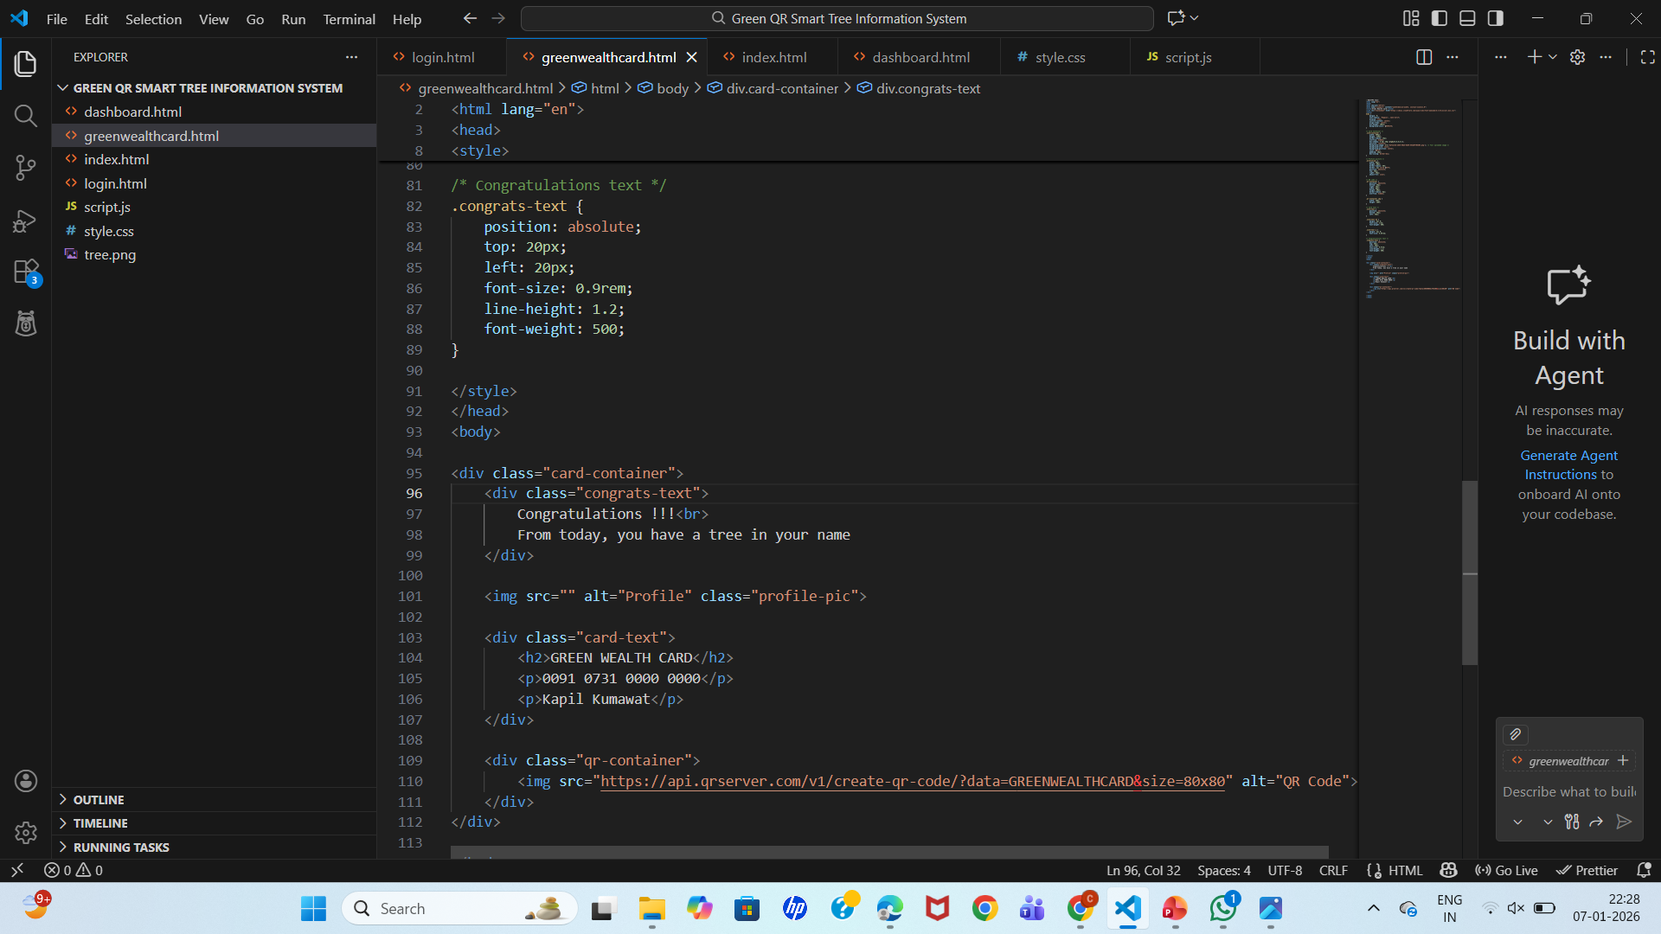
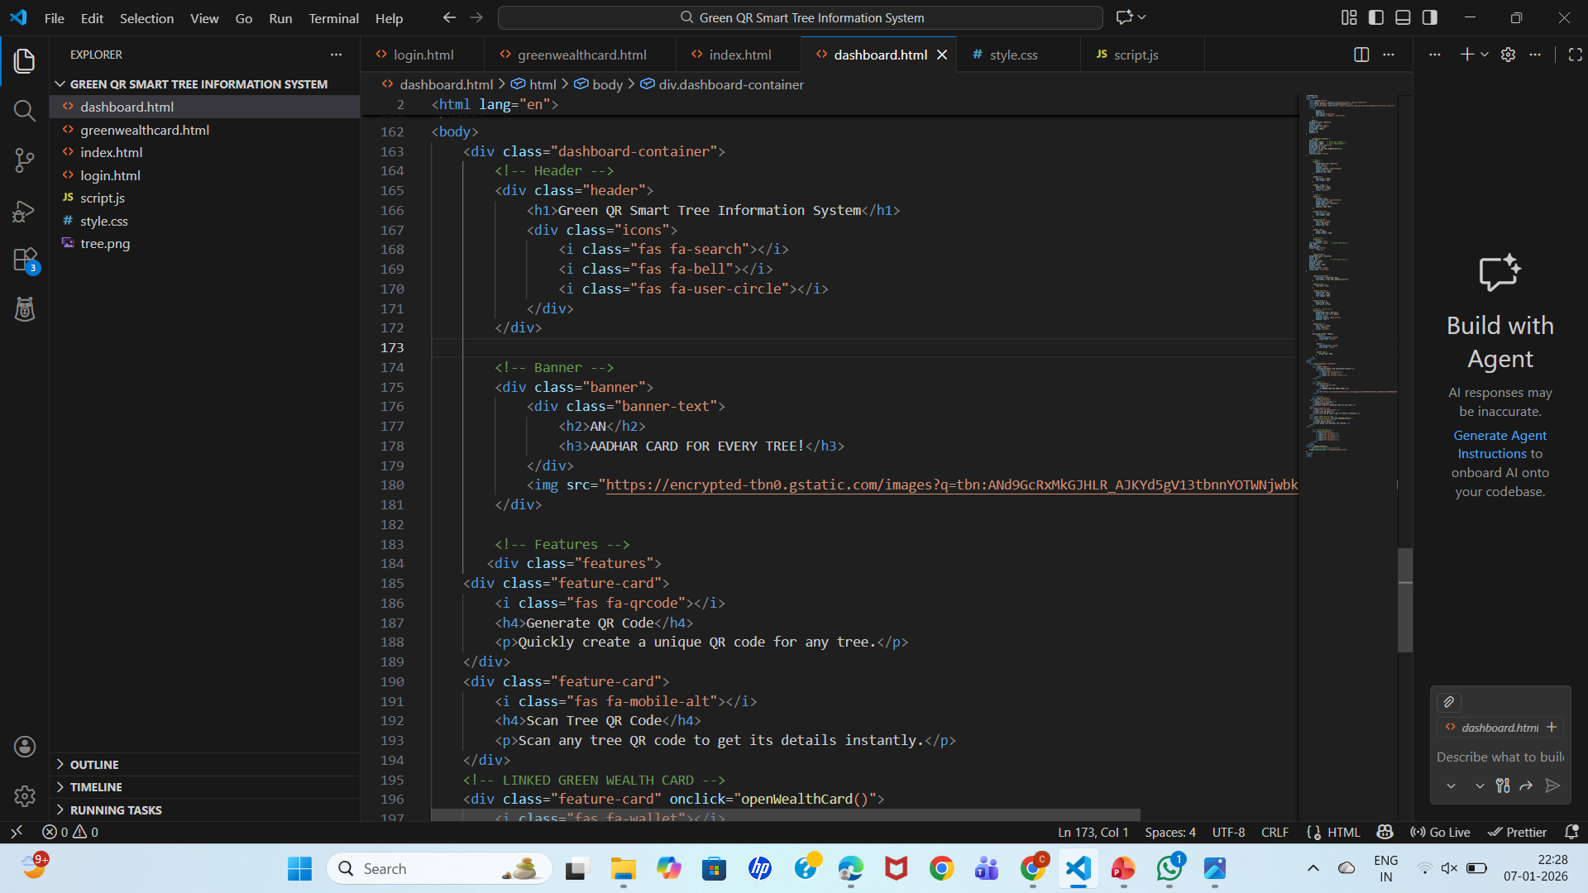
Implementation

Slide 10
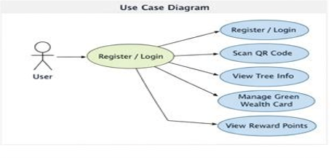
UML Diagram of Use Case
This Use Case Diagram represents the functionalities of the system and how the user interacts with them.
The User is the main actor who uses the application.
First, the user performs Register / Login to access
the system.
After logging in, the user can:
Scan QR Code placed on a tree to identify it.
View Tree Info, such as tree name, location, benefits,
and other details.
Manage Green Wealth Card, which stores eco-related activities and links trees.
View Reward Points earned for scanning trees and contributing to green initiatives.

Slide 11
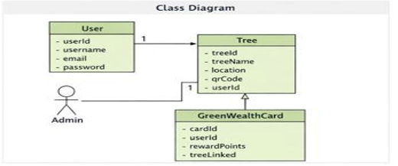
UML Diagram of Class
This Class Diagram shows the data structure of the system, including classes, their attributes, and relationships.
User Class
Stores user details such as userId, username, email, and
password.
Represents people who use the application.
Tree Class
Stores tree-related information like treeId, treeName,
location, QR code, and userId.
Each tree is linked to a user through the userId.
GreenWealthCard Class
Contains cardId, userId, rewardPoints, and treeLinked.
Used to track eco-rewards earned by the user.

Slide 12
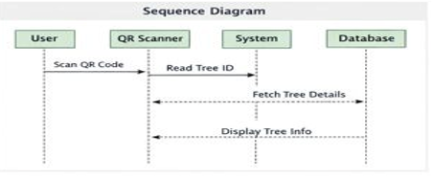
UML Diagram of Sequence
This Sequence Diagram explains the step-by-step interaction between different components when a user scans a tree QR code.
Participants involved:
User
QR Scanner
System
Database
Flow of actions:
The User scans the QR code placed on the tree.
The QR Scanner reads the Tree ID from the QR code.
The System sends a request to the Database to fetch tree details.
The Database returns the tree information to the system.
The System displays the tree information to the user.

Slide 13
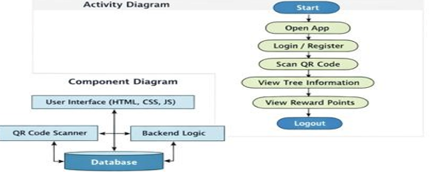
UML Diagram of Activity & Component
Activity Diagram
Shows the step-by-step flow of user actions in the system.
Starts from opening the app and ends with logout.
Includes main activities like login/register, QR
code scanning, viewing tree details, and reward points.
Helps understand the overall working process of the
application.
Component Diagram
Shows the high-level system architecture of the application.
Consists of User Interface, QR Code Scanner, Backend Logic, and Database.
Explains how data flows between frontend and backend components.
Helps in understanding system design and integration.

Slide 14
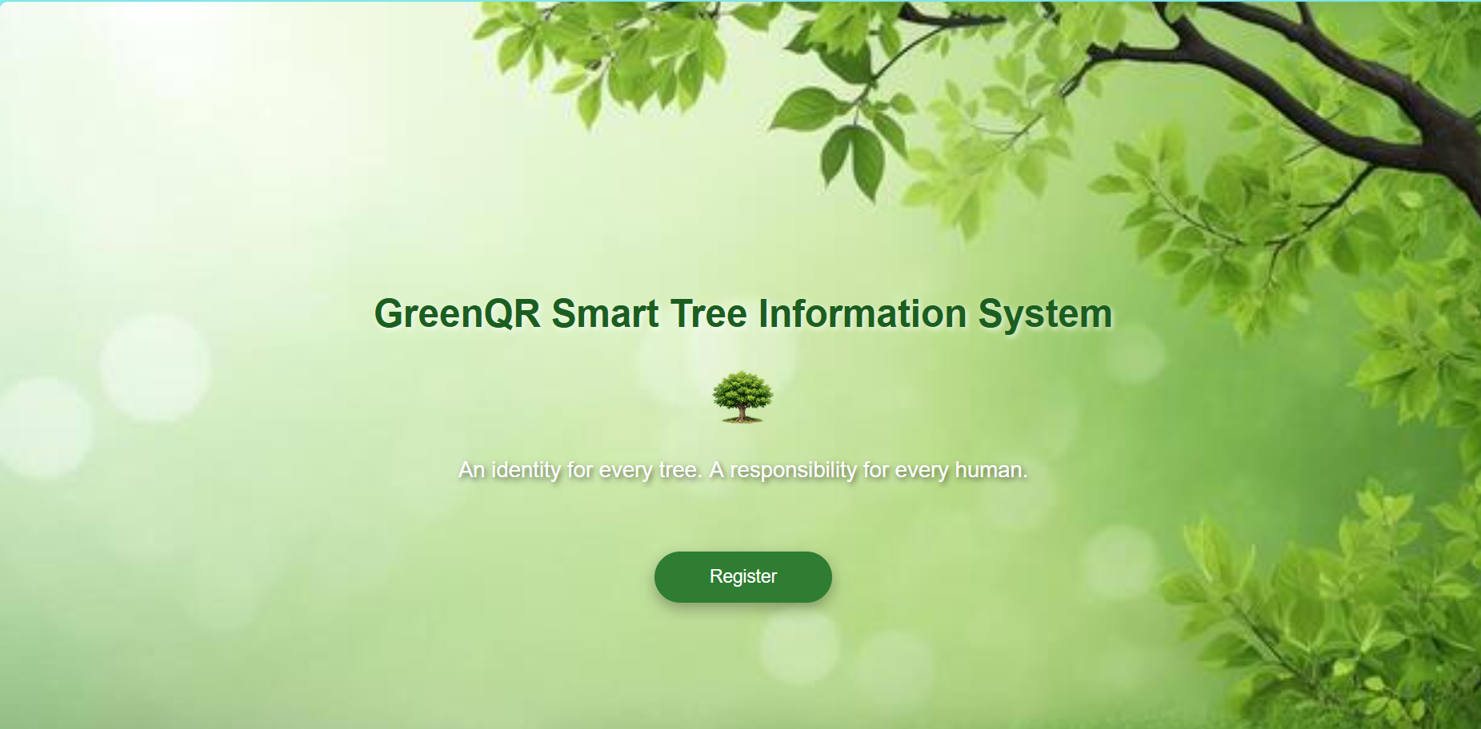
Outputs

Slide 15
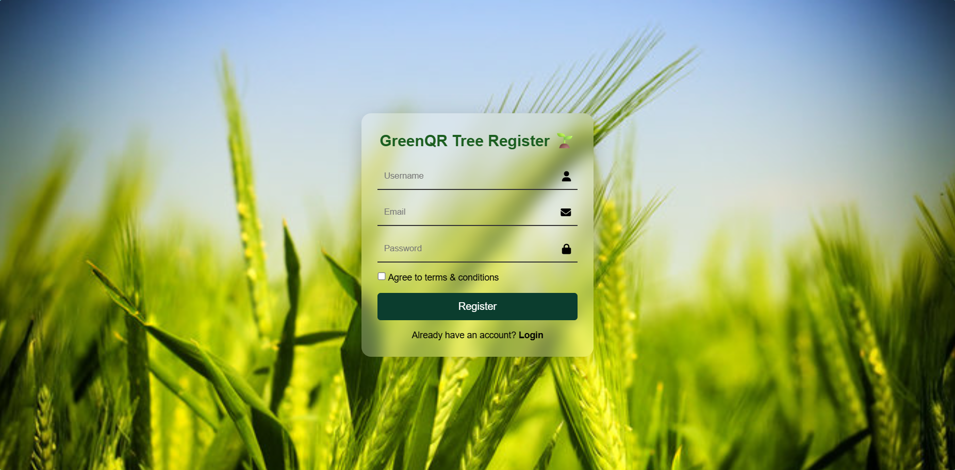
Outputs Cont…..

Slide 16
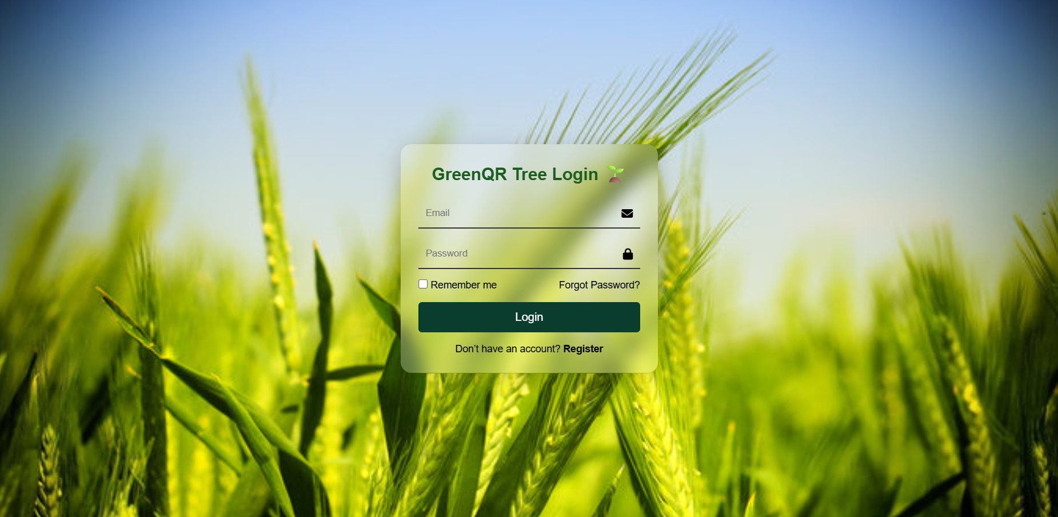
Outputs Cont…..

Slide 17
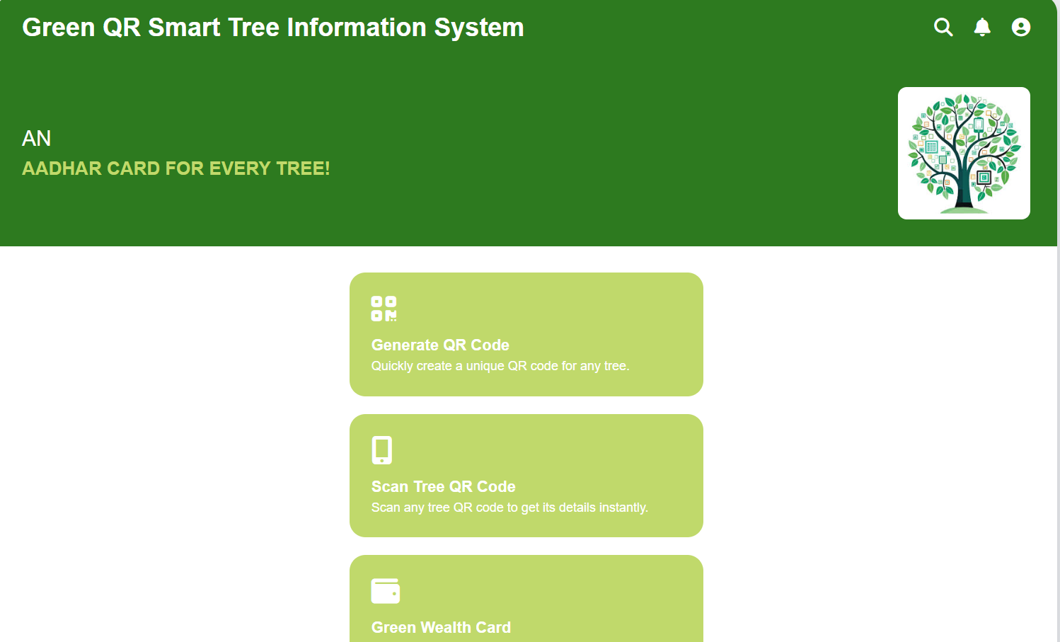
Outputs Cont…..

Slide 18
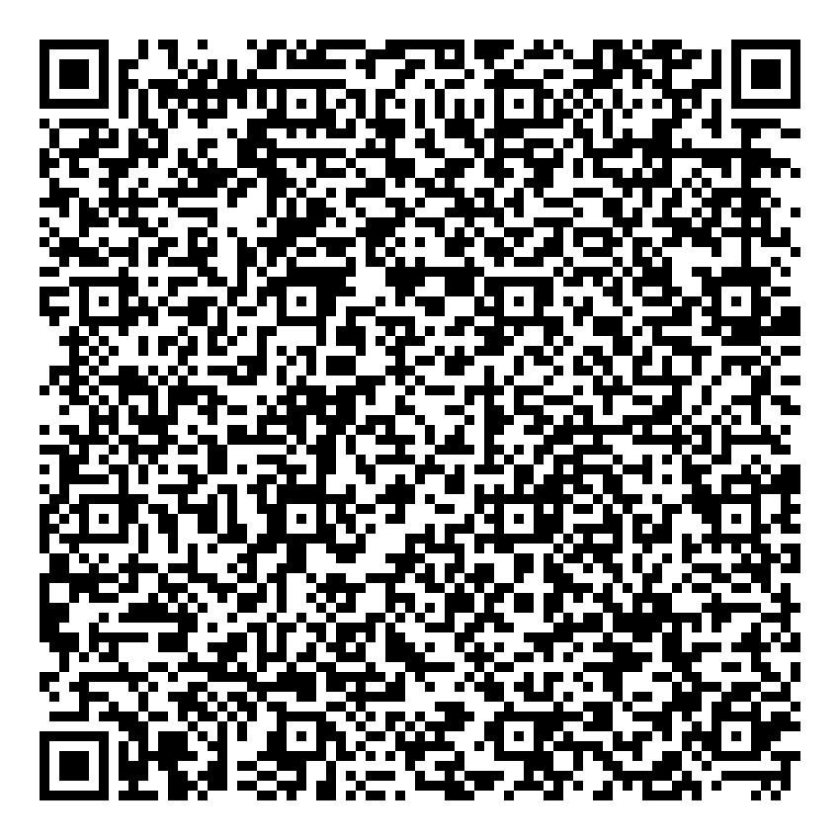
Outputs Cont…..
Tree ID: GG-001
Tree Name: Neem
Scientific Name: Azadirachta indica
Age: 5 Years
Location: College Campus
Advantages: Produces oxygen, purifies air, antibacterial properties
Disadvantages: Bitter taste, excessive use may cause irritation
Medicinal Uses: Skin diseases, dental care, fever treatment
Oxygen: High oxygen production
Helpfulness: Improves human health, provides shade and oxygen for animals

Slide 19
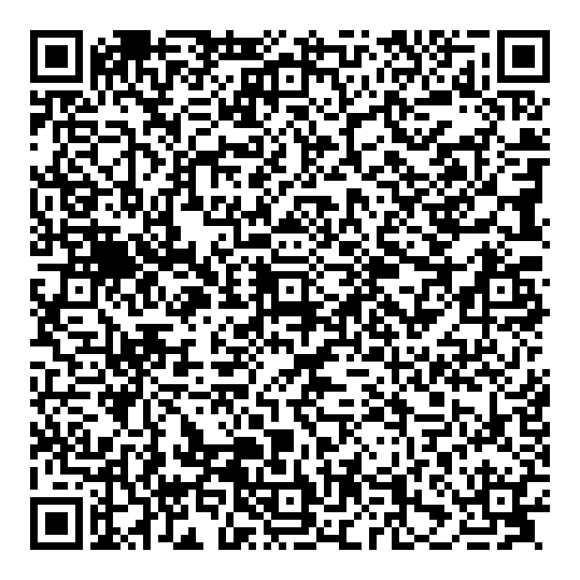
Outputs Cont…..
Tree ID: GG-003
Tree Name: Guava
Scientific Name: Psidium guajava
Age: 3 Years
Location: Garden
Advantages: Nutritious fruits, air purification
Disadvantages: Attracts insects
Medicinal Uses: Diarrhea treatment, vitamin C source
Oxygen: Moderate oxygen production
Helpfulness: Food and medicine for humans, fruits for animals

Slide 20
Conclusion
The Green QR: Smart Tree Information System provides accurate and digital access to tree information through QR codes, ensuring efficient and user-friendly data retrieval.
The project reduces manual record maintenance and promotes an eco-friendly, paperless system for managing tree data.
It improves environmental awareness and enables effective monitoring of trees in campuses, institutions, and public spaces.
In the future, the system can be enhanced with GPS tracking, mobile application support, and IoT sensors for real-time tree health monitoring.
The integration of Artificial Intelligence (AI) can help in analyzing tree growth, predicting diseases, and supporting smart city and large-scale environmental management.

Slide 21
References
Book
[1] I. Sommerville, Software Engineering, 10th ed. Boston: Pearson Education, 2016.
Journal Article
[2] A. Sharma and R. K. Gupta, “QR code based information systems for smart environment management,” International Journal of Computer Applications, vol. 175, no. 12, pp. 15–19, June 2020.
Newspaper Article
[3] “Digital technology supports green initiatives in smart cities,” The Times of India, vol. 183, pp. 6–7, March 12, 2022.
Technical Report
[4] Ministry of Environment, Forest and Climate Change, “Digital solutions for environmental monitoring,” Government of India, Technical Report ENV-TR-2021-08, August 2021.

Slide 22
Thank You

Slide 23
Any Queries

